Slide 1
MAHCINING SCIENCE AND MACHINE TOOLS
MODULE 03

Slide 2
LATHE
Lathe is the oldest machine tool invented
Versatile and widely used machine tool
Mother of all other machine tool
Remove metal from the job in the form of chips by rotating work against a single point cutting tool
Job held in the chuck or in between centres

Slide 3
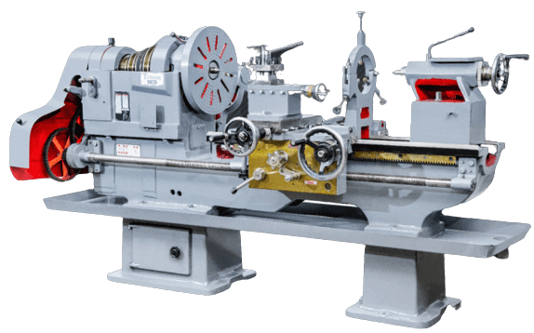
TYPES OF LATHE
Centre lathe
Bench lathe
2. Tool room lathe
3. Special purpose lathe
Copying lathe
Gap bed lathe
Hollow spindle lathes
4. Capstan and Turret lathes
5. Automatic lathes

Slide 4
LATHE
The centre lathe is the most common of the lathes, which derives its name from the way a work piece is clamped by centres in a lathe, though this is not the only way in which the hob is mounted.
This is also called engine lathe in view of the fact that early lathes were driven by steam engines
The too room lathe is generally meant for applications of tool making, where the accuracy desired is much higher than is normally required for general production work, also the range of sizes and materials handled would normally be large.
The special purpose lathes are developed from the centre lathe, to cater to special forms of application which cannot be handled by the conventional centre lathe
Capstan and turret lathes and automatic lathes are the form of lathes to cater for high rate production and thus would be used for very special applications. These have the special features to help in improving the production rate and also work unattended if necessary.

Slide 5
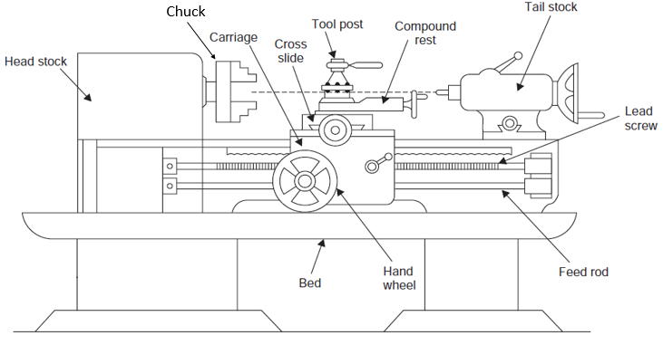
CENTRE LATHE

Slide 6
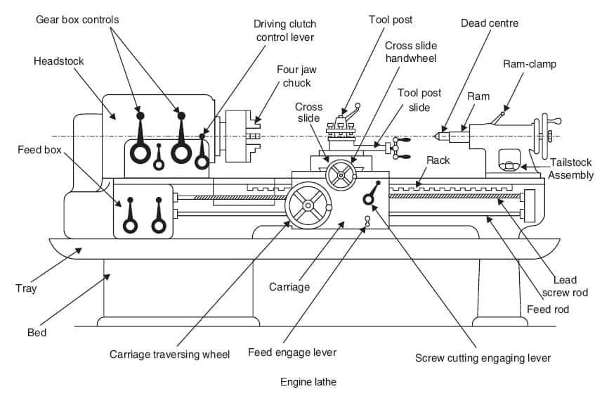

Slide 7
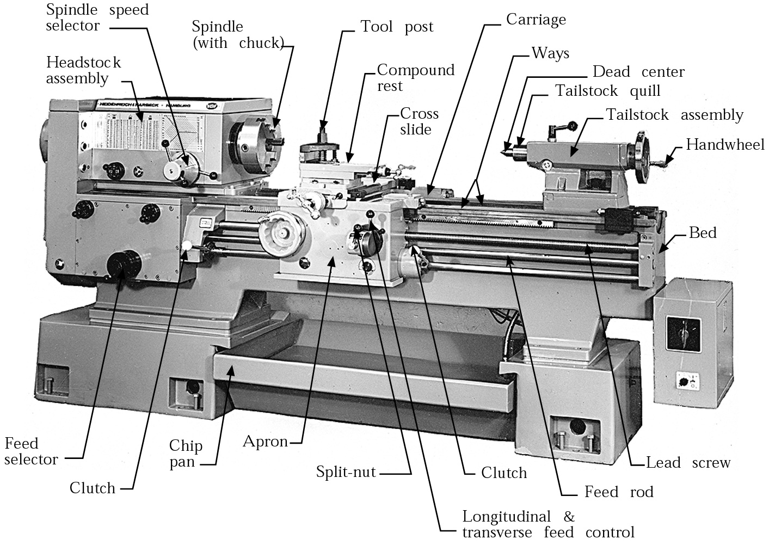

Slide 8
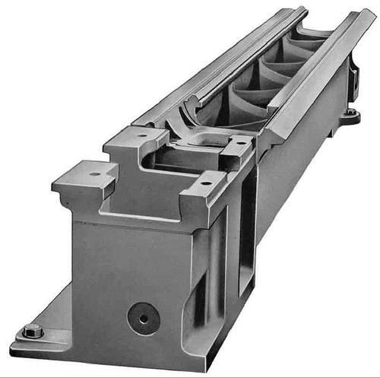
LATHE BED
Forms base and support other working parts
Made of grey cast iron
Guide ways are flat or inverted V shaped
Inner ways provide sliding surfaces for the tailstock and the outer ways for the carriage

Slide 9
HEADSTOCK
Houses the power source
All the power transmission, gear box and the spindle
Fixed at the left most end on the bed
Spindle is hollow and should be sufficiently rigid to provide accurate rotary motion and maintains perfect alignment with the lathe axis
A lice centre fits into the Morse taper in the spindle hole for the purpose of locating the work piece axis
The main gear box provides the necessary spindle speeds considering the range of materials to be turned in the lathe
The headstock also houses the feed ear box to provide the various feed rates and thread cutting ranges

Slide 10
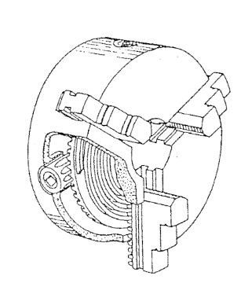
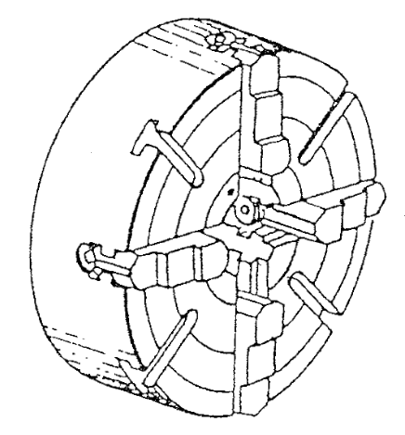
CHUCK
THREE JAW CHUCK
The three jaw chuck is self centering
The jaws all move together and are always the same distance from the centre
This chuck is designed to hold round or hexagonal work
The movement of the jaws is controlled by a scroll plate which is rotated by a chuck key
2. FOUR JAW CHUCK
The 4 jaw chuck has jaws that can be moved independently of each other
This chuck is used to hold irregular or odd shaped work
It requires careful setting up
It holds work firmer and work can be made to run perfectly true with the aid of a dial indicator

Slide 11
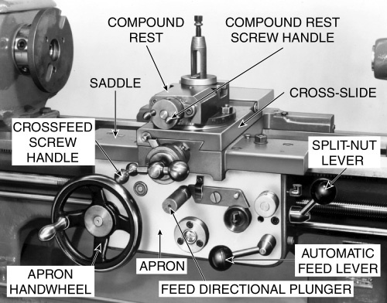
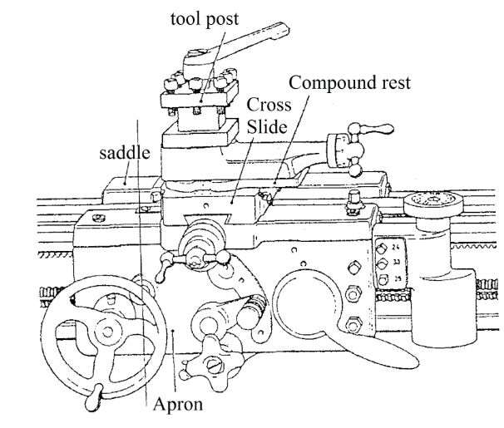
CARRIAGE
Used to move cutting tool along lathe bed
Consists of following parts
Saddle : H-shaped casting mounted on top of lathe ways.
Cross-slide: Mounted on top of saddle. Carries compound rest and tool post. Used to give depth of cut
Compound rest : Circular base with graduation mounted on cross slide. Used for turning short tapers and angular cut .Tool post held on compound rest
Apron : Lower part. Contain gears, clutches for transmitting motion from feed rod to carriage also contain split nut which engages lead screw for thread cutting.

Slide 12
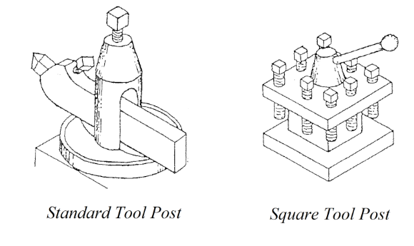
TOOL POST
The tool post is a device for firmly clamping the cutting tool or tool holder to the lathe
The tool post is fixed to the top of the compound slide
Below is a standard tool post and the square tool post which can hold 4 different cutting tools

Slide 13
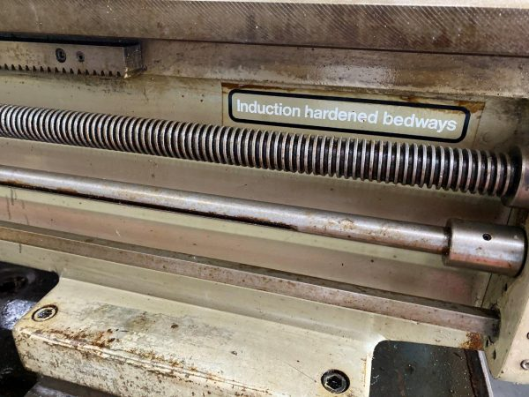
LEAD SCREW
Long threaded bar , located slightly below and parallel to the bed ways
Fitted to the carriage
Engaged or disengaged by split nut
Engaged with carriage for cutting threads
FEED ROD
Used for operating the carriage in automatic turning
Obtain motion from spindle and transmits to carriage through gear train

Slide 14
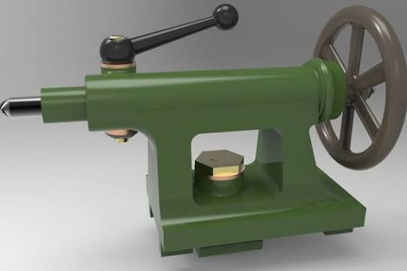
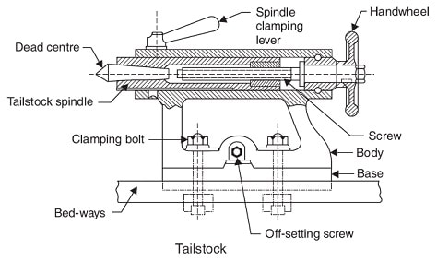
TAILSTOCK
Towards the right most end on the bed
Houses the tailstock spindle for the purpose of locating the long components by the use of centres
Movable on the inner guideways provided on the bed to accommodate the different lengths of work pieces
Serves the purpose of holding tools such as centre drill, twist drill, reamer etc… for making and finishing holes in the components

Slide 15
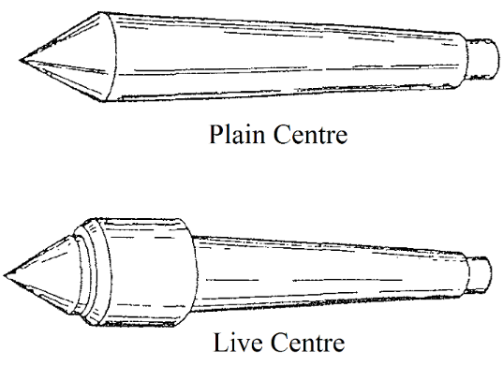
CENTRES
The headstock and tailstock spindles are bored out to standard morse taper to receive headstock and tailstock centres whose shanks are also morse tapers
The points are ground to an angle of 60 degrees to fit the countersink section of a centre drill
The tailstock centre supports the right hand end of the work
The work rotates on the bearing surface of this centre so it must be hardened and well lubricated
Live centres are used in the tailstock and have built in roller or ball bearings which enable the point of the cnetre to rotate with the work.

Slide 16
LATHE SPECIFICATIONS
Distance between centres – maximum length of the job that can be turned in the lathe
Swing over the bed – maximum diameter of the job that can be turned in the lathe
Swing over the cross slide – maximum diameter of the job that can be turned in the lathe machine with the job across the cross slide
Horse power of the motor, cutting speed range, feed range, screw cutting capacity, accuracy achievable, spindle nose diameter and hole size,

Slide 17
WORK HOLDING DEVICES
Easy and quick to operate, and should ensure rigidity against heavy cuts
Commonly used work holding devices are
1. Collect chucks
2. Jaw chucks
3. Arbors
4. fixtures

Slide 18
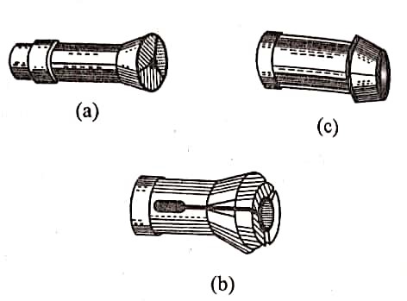
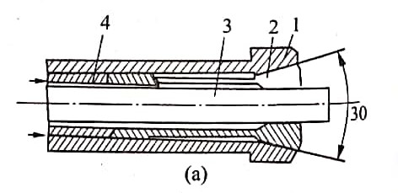
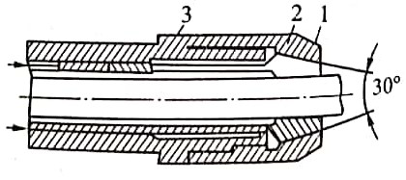
1. Collet chucks
Used to clamp bar stock in machining on turret lathes
which is a steel sleeve with split tapered portion forming jaws
Clamp bar 3 when tube 4 together with collet 2 is shifted to the left until the jaws of the collet are contracted by inner tapered hole of spindle 1
The drawback of this arrangement is an axial bar displacement in clamping, which decreases the accuracy of axial bar positioning
On clamping bar, collet 1 is removed to the right and the outer taper of collet is contracted under the action of the inner taper of stop nut 2, screwed on spindle 3. the conventional collect taper angle is 30°
Collet chuck may be hand operated or air operated

Slide 19
2. Jaw chucks
Used to hold irregular shaped individual work pieces
Various jaw chucks employed for the said purpose are
1. Three jaw self-centering chuck
2. Four jaw independent chuck
3. Two jaw box chuck
4. Power chucks
Two jaw box chuck is used for holding specially the work pieces having parallel flat sides
Power chucks are operated by air pressure, or hydraulic pressure.

Slide 20
3. Arbors
Used for holding small work pieces having accurately drilled holes in them
Threaded type and expanding types arbors are in use
4. Fixtures
Special fixtures may be employed to hold jobs which cannot, otherwise, be held in collets, jaw chucks or arbors.

Slide 21
LATHE DOGS
1. Standard bent-tail lathe dog
Most commonly used for round work pieces
Available with square-head setscrews of headless setscrews
2. Straight-tail lathe dog
– Driven by stud in drive plate
– Used in precision turning

Slide 22
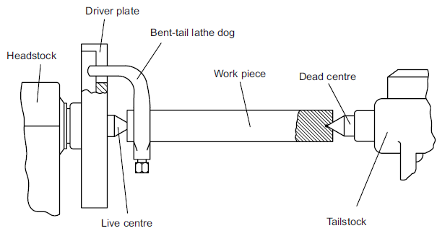
3. Safety clamp lathe dog
Used to hold variety of work
Wide range of adjustment
4. Clamp lathe dog
– Wider range than others
– Used on all shapes

Slide 23
TOOL HOLDING DEVICES
Left hand offset holder
Offset to the right
Designed for machining work close to chuck or faceplate and cutting right to left
Designated by letter L
2. Right hand offset holder
Offset to the left
Designed for machining work close to the tailstock and cutting left to right
Also for facing operations
Designated by letter R

Slide 24
3. Straight tool holder
General-purpose type
Used for taking cuts in either direction and for general machining operations
Designated by letter S

Slide 25
LIMITATIONS OF CENTRE LATHE
The setting time for the job in terms of holding the job is large.
Only one tool can be used in the normal course. Sometimes the conventional tool post can be replaced by a square tool post with four tools.
The idle times involved in the setting and movement of tools between the cuts is large.
Precise movement of the tools to destined places is difficult to achieve, unless proper care is exercised by the operator.

Slide 26
LATHE OPERATIONS
➢ Turning: to remove material from the outside diameter of a work piece to obtain a finished surface.
➢ Facing: to produce a flat surface at the end of the work piece or for making face grooves.
➢ Boring: to enlarge a hole or cylindrical cavity made by a previous process or to produce circular internal grooves.
➢ Drilling: to produce a hole on the work piece.
➢ Reaming: to finishing the drilled hole.
➢ Threading: to produce external or internal threads on the work piece.
➢ Knurling: to produce a regularly shaped roughness on the work piece.

Slide 28
TAPER TURNING
Cutting tapers on a lathe is one of the most common applications. A number of methods are available for cutting tapers in a lathe. They are:
1. Using a compound slide
2. Using form tools
3. Offsetting the tailstock
4. Using taper turning attachment

Slide 29
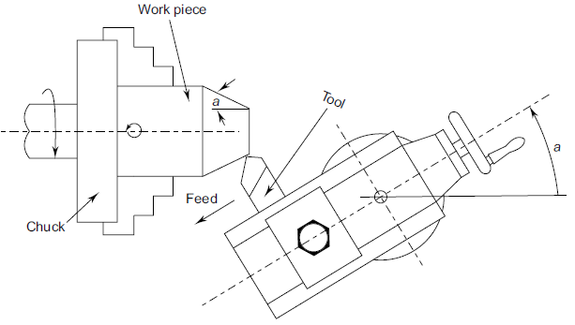
Using a compound slide
The compound slide is an auxiliary slide underneath the tool post and above the carriage. It is possible to swivel the compound slide to the desired angle of the taper
The tool is then made perpendicular to the work piece and feed is given manually by the operator. Some of the features of this method are:
Short and steep tapers can be easily done.
Limited movement of the compound slide.
Feeding is by hand and is non-uniform.

Slide 30
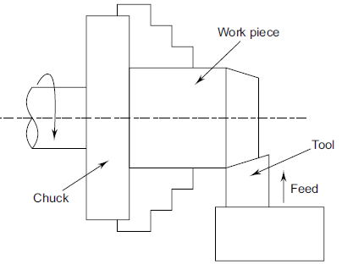
2. Using form tools
The feed is given by plunging the tool directly into the work.
This method is useful for short tapers, where the steepness is of no consequence, such as for chamfering.
When turning long tapers with form tools, the tool is likely to chatter (vibrate) resulting in poor surface finish.
However, care of the form tools, particularly for regrinding is a careful exercise. The cutting edge should be perfectly straight for good accuracy.

Slide 31

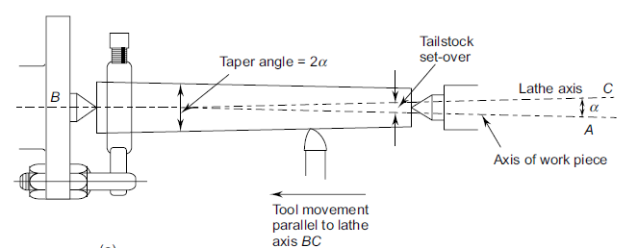
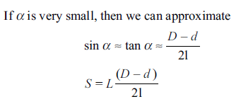

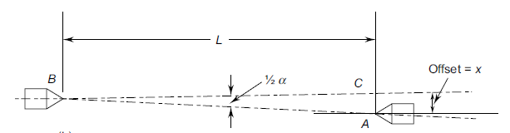
3. Offsetting the tail stock
By offsetting the tailstock, the axis of rotation of the job is inclined by the half angle of taper
The feed to the tool is given in the normal manner parallel to the guide ways. Thus the conical surface is generated.

Slide 32
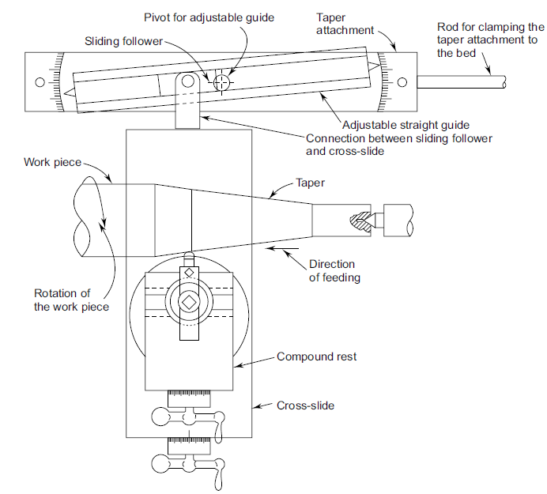
4. Using taper turning attachment
In this method a separate slideway is arranged at the rear of the cross slide.
This slide can be rotated at any angle to be setup.
The block that can slide in this taper slide way is rigidly connected to the cross slide
The cross slide is made floating by disconnecting it from its lead screw.
As the carriage moves for feeding, the block moves in the inclined track of the slide, it gets the proportional cross movement perpendicular to the feed direction, the cross slide and in turn the cutting tool gets the proportional movement.
Thus the tool tip follows the taper direction set in the attachment. However, in this condition, the cross slide cannot be used for normal turning operations.

Slide 33
THREAD CUTTING
Thread cutting can be considered as another form of turning since the path to be travelled by the cutting tool is helical
The shape of the cutting tool is of the same form as the thread to be generated
For the purpose of feeding the tool for generating the thread, the feed is given by the lead screw. Feed is same as the lead of the pitch to be generated.
The depth of cut in the case of thread cutting can be given in two ways, plunge cutting and compound cutting
Plunge cutting
In the case of plunge cutting, the cutting of the thread takes place along both the flanks of the tool.
This would mean that the cutting tool would have to be provided with a zero or negative rake angle.
In addition the relief along the cutting edges cannot be provided in view of the form to be achieved.
Cutting is also taking place along a longer length of the tool.
This gives rise to difficulties in machining in terms of higher cutting forces and consequently chattering (violent vibrations).
This results in poor surface finish and lower tool life, thus this method is not generally preferred.

Slide 34
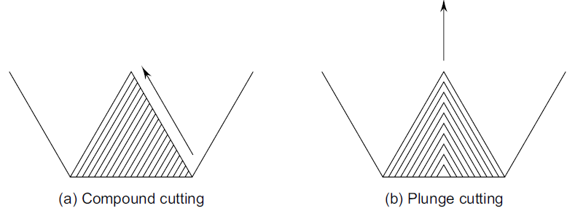
2. Compound cutting
With the compound feeding, the tool needs to be moved in both the directions (along the bed as well as a direction perpendicular to it) simultaneously to position the tool tip along one flank of the thread.
This configuration helps in smoother flow of chips as the cutting takes place only along one cutting edge.
This method therefore is much preferred
Only problem is to move the tool for giving the depth of cut along the flank of the thread, which can be achieved by the use of compound slide for giving the depth of cut while feed is given by the carriage in the conventional manner

Slide 35
The compound slide is rotated by the half angle of the thread, and the cutting tool is adjusted to make it perpendicular to the work piece surface. For this purpose a thread setting gauge which contains the required form of the thread being cut is kept perpendicular to the surface of the work piece, and the tool tip is set
The next important consideration for thread cutting is the feeding of the tool along the helical path. For this purpose, the lead screw is normally employed for feeding the tool along the length of the job. In turning the engaging of tool at any point would be of no consequence since the surface to be generated is cylindrical.
However in thread cutting it is essential that the tool tip should always follow the same thread profile generated in the first cut, otherwise no thread would be generated.

Slide 36
The next important consideration for thread cutting is the feeding of the tool along the helical path.
For this Purpose , the lead screw is normally employed for feeding the tool along the length of the job. In turning the engaging of tool at any point would be of no consequence since the surface to be generated is cylindrical.
However in thread cutting it is essential that the tool tip should always follow the same thread profile generated in the first cut, otherwise no thread would be generated.
One of the methods that can be followed in this case is to reverse the spindle while retaining the engagement between the tool and the work piece. The spindle reversal would bring the cutting tool to the starting point of the thread following the same path in reverse.
After giving a further depth of cut the spindle is again reversed and the thread cutting is continued in the normal way.
This is easy to work and is somewhat more time consuming due to the idle times involved in the stopping and reversing of the spindle at the end of each stroke.

Slide 37
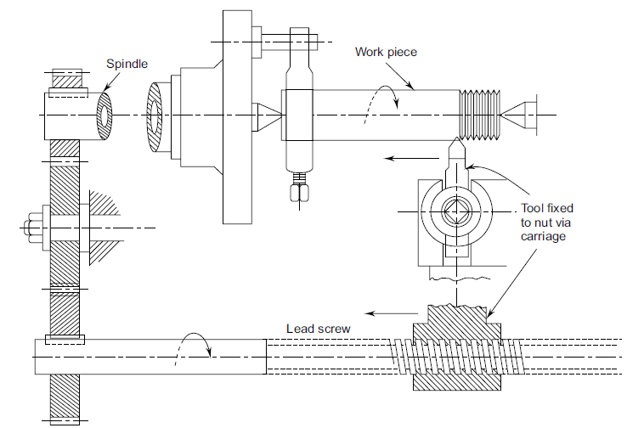

Slide 38
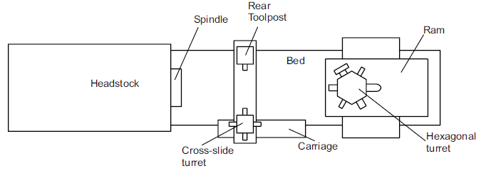
TURRET AND CAPSTAN LATHE

Slide 39
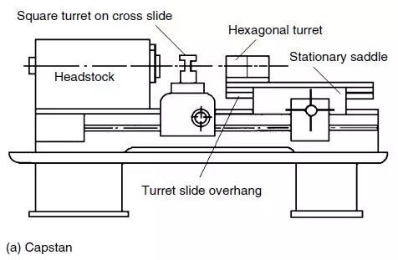
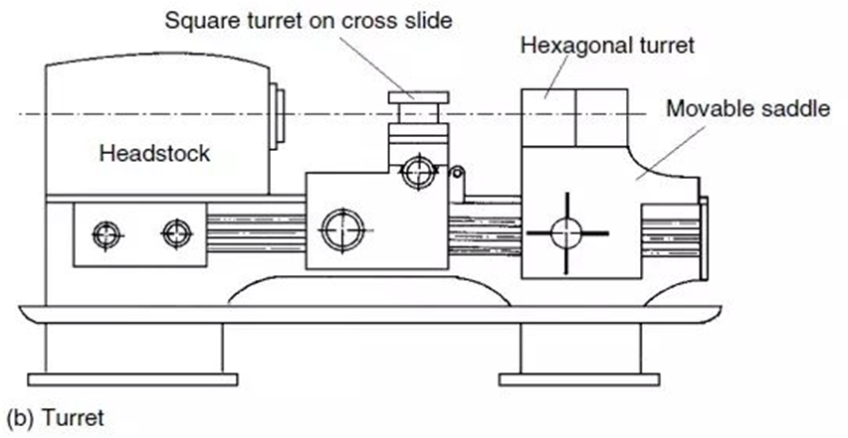

Slide 40
Capstan lathe | Turret lathe
It is a light duty machine | It tis a heavy duty machine
The turret head is mounted on the ram and the ram is mounted on the saddle | The turret head is directly mounted on the saddle and the saddle slides over the bed ways
The saddle will not be moved during machining | The saddle is moved along with the turret head during machining
The length wise movement of turret is less | The lengthwise movement of turret is more
Short work pieces only can be machined | Long work pieces can be machined
It is easy to move the turret head as it slides over the ram | It is difficult to move the turret head along with saddle
The turret head cannot be moved crosswise | The turret head can be moved crosswise in some turret lathes
As the construction of lathe is not rigid, heavy cut cannot be given | As the construction of lathe is rigid, heavy cut can be given
It is used for machining work pieces up to 60 mm diameter | It is used for machining work pieces up to 200 mm diameter
Collet is used to hold the work piece | Jaw chuck is used to hold the work piece

Slide 41
Various differences between capstan and turret lathes, and a general purpose centre lathe are:
1. Headstock has more range of speeds and is heavier to allow for higher rate of production.
2. Tool post is indexable (four tools). Any one tool can be brought into cutting position.
3. Tail stock is replaced by a tool turret with six tool positions.
4. Feed of each tool can be regulated by means of feed stops.
5. Two or more tools mounted on a single tool face can cut simultaneously.
6. Semi-skilled operators are required.
7. Used for production operations involving better repeatability

Slide 42
AUTOMATIC LATHES
The term automatic is somewhat loosely applied, but is normally restricted to those machine tools capable of producing identical pieces without the attention of an operator after each piece is completed.
All operations in machining a work piece on a metal cutting machine tool are classified as processing and handling operations. Processing operations are those in which the actual cutting process or chip removal takes place.
The rest are handling operations and include loading and clamping the work, advancing and withdrawing the cutting tools, releasing and unloading the work, checking the size of the work, etc. Highly automated machine tools especially of the lathe family are ordinarily classified as automatics and semi-automatics.
Automatics as their name implies are machine tools with a fully automatic work cycle.
Semi-automatics are machine tools in which the actual machining operations are performed automatically in the same manner as on automatics. In this case however, the operator loads the blank into the machine, starts the machine, checks the work size and removes the completed piece by hand.

Slide 43
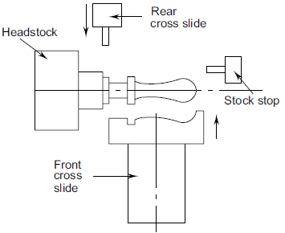
1. AUTOMATIC CUTTING OFF MACHINES
Used for turning, facing and cutting off operations
Special operations such as form turning, drilling and threading can also be performed
Required length of stock is fed out with a cam mechanism up to stock stop and is held in collet chuck of the rotating spindle
Tools on the front cross slide perform operations of turning or forming whereas tools on the rear cross slide perform the facing, chamfering and cutting off operations

Slide 44
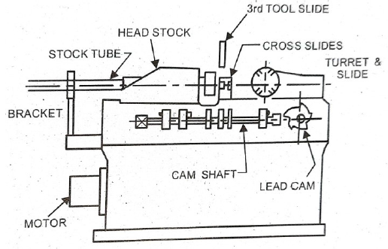
2. SINGLE SPLINDLE AUTOMATIC SCREW MACHINES
Designed for manufacturing bolts and screws from bar stock in mass production
Also used for producing small parts of complex shape
Bar is advanced through stock tube up to stop and is clamped in the rotating spindle by means of collet chuck
Turret carried six tools and are used for longitudinal turning and machining of the central holes
At the end of each cut turret slide is withdrawn automatically and indexed to bring next tool in position

Slide 45
3. SWISS TYPE AUTOMATIC SCREW MACHINES
Head stock is movable and the tools are fixed in the slides
Also called as sliding head type automatic screw machine
Used for mass production of long accurate parts of small diameter bar stock
Features are
1. A sliding headstock through which bar stock fed
2. Tool bracket which supports five tools slides and also a guide bush to support the bar stock
3. A special attachment mounted on the right hand side of the bed
4. A camshaft at the front of the machine
Five single point tools are placed radially on the tool head around the bushing
Tools on horizontal slide performs plain turning while other tools on three slides are used for knurling, chamfering, recessing and cutting off operations
Tools are controlled by cams that brings the tools in as required for different operations

Slide 46
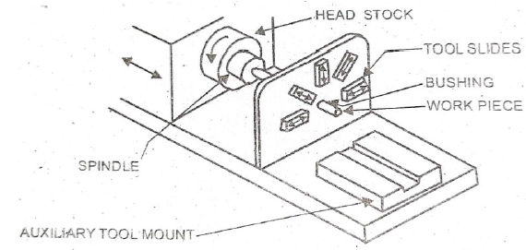
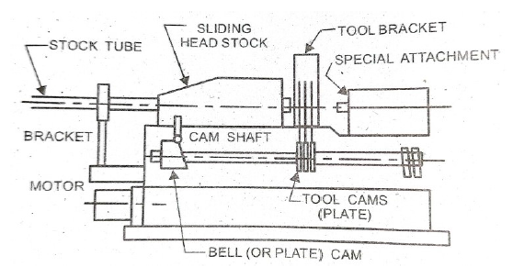

Slide 47
RECIPROCATING MACHINE TOOLS
Shaper
Planer
Slotter

Slide 48
1. SHAPER
The shaper is a relatively slow machine tool with very low metal removal capability
This is a low cost machine tool and hence is used for initial rough machining of the blanks.
It is rarely used in production operations.
It uses a single point tool similar to a lathe which is clamped to a tool post mounted to a clapper box which in turn is mounted to a reciprocating ram
The ram while undertaking the cutting stroke pushes the cutting tool through the work piece to remove the material.
When the ram returns, no cutting takes place.
In between the return and cutting strokes, the table moves in the horizontal direction perpendicular to the cutting direction, which is termed as the feed direction.

Slide 49
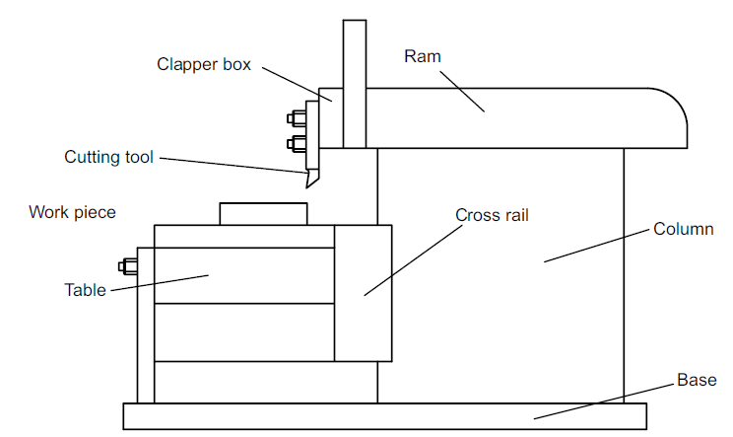
SHAPER - CONSTRUCTION
The Base
Column
Ram
Tool head (clapper box)
Cross rail
Table

Slide 50
The Base: The base provides the stability for the shaper as it supports all other equipment present as well as absorbs the forces coming due to the cutting.
Generally it is made of grey cast iron and has the necessary arrangement of bolts so that it can be bolted to the factory floor with proper levelling.
2. Housing (column): The housing is a box like structure to provide the necessary rigidity and also houses all the motors and power transmission equipment.
On the top of the housing the necessary guide ways are provided for the linear motion of the ram for the cutting stroke.
3. Ram: It is the part of shaper that provides the reciprocating motion for the cutting tool. Ram gets the motion directly from the quick return mechanism present in the housing.

Slide 51
4. Tool head (clapper box):
The single point cutting tool is clamped in the tool head.
The tool head has the ability to swivel the cutting tool at any angle while clamping the tool with any overhang depending upon the requirement.
The swiveling ability is important for the tool to machine surfaces that are not in horizontal plane.
Further the tool should be firmly supported during the forward motion to carry out the material removal.
During the return stroke, the cutting tool will not do the cutting and hence will be an idle stroke.
If the tool is held firmly as in the cutting stroke, the tool will rub the already machined work piece and also the flank surface of the tool will wear out quickly. To reduce this, the tool is lifted during the return stroke by the clapper box arrangement

Slide 52
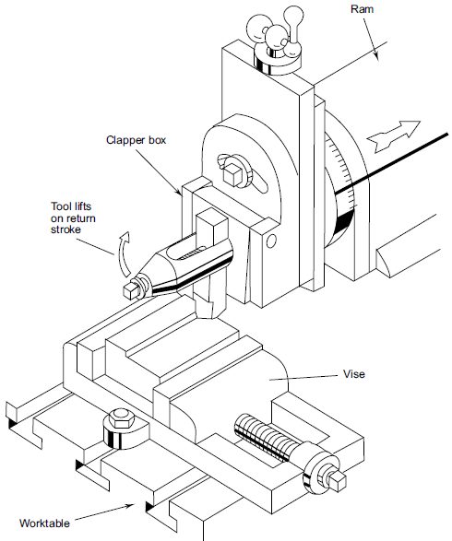

Slide 53
5. Table: A heavy table is present at the front end of shaper. Table is provided with T-slots for mounting the work pieces or work holding fixtures. The table can be moved up and down along the guide ways provided on the cross rail attached to the housing.
A shaper is generally used for machining flat surfaces in horizontal, vertical and angular directions. It can also be used for machining convex and concave curved surfaces. The actual surface generated is by means of the linear motions of the cutting tool.

Slide 54
PLANING MACHINE (PLANER)
Planing machine is very similar to the shaper in terms of the surfaces that can be generated. Generally planer is used for machining large work pieces, which cannot be held in the shaper.
In the shaper, the cutting tool reciprocates during the cutting motion, while in the case of planer the work table reciprocates.
Feeding motion in the planer is given to the cutting tool, which remains stationary during the cutting motion.

Slide 55
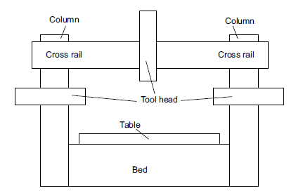
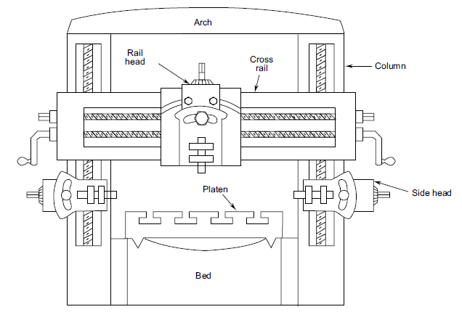

Slide 56
Bed: The bed of a planer, generally made of cast iron, is large in size and consequently is heavier to support the heavy machine. Levelling jacks, or pads, are included on the bottom of the bed to provide a means of levelling it during installation. The bed is a little more than twice the length of the table to provide the full reciprocating motion for the entire part mounted on the table
Table: The table is the platform where the work will be setup for machining. The table supports and reciprocates the heavy work pieces during the cutting action. The table moves back and forth on the bed, carrying the work past the stationary tool. T-slots are provided on the entire length of the table for securely fastening the work pieces to the table. In addition to the T-slots, a row of holes are provided on the table to accept stop pins that prevent the movement of the work under the heavy cuts common to the planer

Slide 57
Column: On either side of the bed two heavily ribbed columns are located. Two tool heads can be mounted, one on each of these columns. Within the columns are the various mechanisms that transmit power to the upper parts of the machine from the main drive motor.
Cross Rail: A cross rail is connected to the two columns to help in accommodating a third tool head. If necessary an additional tool head can be mounted on the cross rail. The rail can be clamped at any position on the columns by means of hand or power clamps. The tool heads can be fed manually or more generally by automatic feeding arrangement with the power coming from the motor and feed gearbox that is housed within the table.
Tool head: The tool head in planer is similar in construction to the clapper box of a shaper and is mounted on the cross rail through a saddle. The tool head can be moved along the cross rail for the feeding action while the depth of cut can be controlled by moving the tool downwards. The tool head can be tilted for any given angle cut on the work piece. The tool heads will be provided with counterweights for force equalization and smooth movement

Slide 58
SLOTTING MACHINE (SLOTTER)
Slotting machine is basically a vertical axis shaper.
This is a larger version of the vertical shaper with ram strokes up to 1800 mm long.
Thus the work pieces, which cannot be conveniently held in a shaper, can be machined in a slotter.
Generally keyways, splines, serrations, rectangular grooves and similar shapes are machined in a slotting machine.
The stroke of the ram is smaller in slotting machines than in shapers to account for the type of the work that is handled in them.

Slide 59
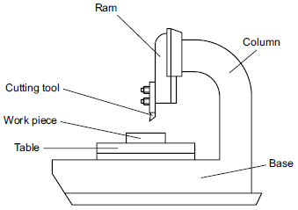
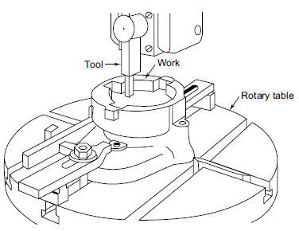

Slide 60
Base: Similar to a shaper and planer the base of the slotter is a heavy structure to support all the weight of the machine tool and the accompanying cutting forces. Since the cutting force in slotting is directed against the table, the base of the machine is rigidly built. Precision guide ways are provided on top of the base for the cross-slide to move.
Table: Table is generally a circular one similar to the rotary table of a milling machine. T-slots are cut on the table to facilitate the fixing of work pieces utilizing various fixturing elements such as T-bolts, clamps, etc. Tables on slotters can be rotated as well as moved longitudinally or transversely. With such flexibility in the feed direction, a slotter can cut any type of groove, slot, or keyway.
Column: The column of a slotter is a support structure to the cutting tool and its reciprocating motion. It is also massive and houses the power and drive mechanism used for the reciprocation of the cutting tool.

Slide 61
Ram: The ram holds and supports the tool head during the cutting action. Since gravity acts on the ram during its upward travel, a counterweight is added to equalize the power requirements on the upward and downward strokes.
This will provide a smooth action to the machine.
The actual cutting takes place during the downward motion of the tool.
The stroke length can be adjusted suitably depending upon the part.

Slide 62
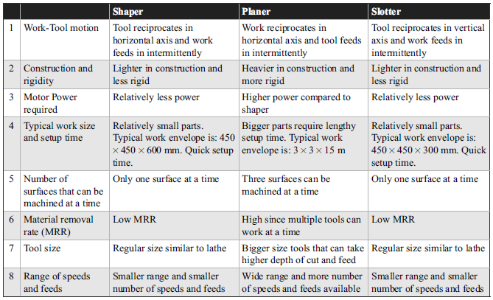

Slide 63
DRILLING MACHINES
Drilling is the operation of producing circular hole in the work-piece by using a rotating cutter called drill.
The machine used for drilling is called drilling machine
Similar operations like boring, reaming, counter boring, counter sinking, tapping etc. can also be performed with the drilling machine.
As the machine exerts vertical pressure to originate hole it is called drill press.

Slide 64
1. Base –
It is a heavy casting on which vertical column is mounted.
2. Column –
It is the vertical member of the drilling machine. It supports table and the head including driving mechanism.
3. Table –
It is mounted on the column. ‘T’ slots are provided on it to clamp the work piece on it. The position of the table can be adjusted vertically on the column to hold the work piece at different height below the drill tool. It can be set in various position in horizontal plane

Slide 65
4. Head –
It is mounted on the top of the column. It consists of driving and feeding mechanism for the spindle.
5. Spindle -
Spindle is a vertical shaft which holds the chuck and drill. Rotary motion of the spindle is given directly to the tool to cut the material from the work piece. It is made of alloy steel.
6. Spindle drive and feed mechanism –
Multiple speeds may be obtained by a step cone pulley drive or by gear. Feed mechanism provided in drilling machine is either by quick reverse hand feed or by sensitive hand feed. The feed movement may be controlled by hand or power.

Slide 66
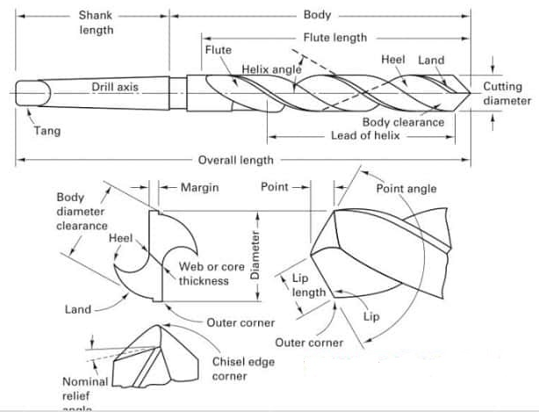
TWIST DRILL NOMENCLATURE

Slide 67
Axis is the longitudinal centre line of drill.
Shank :portion of the drill by which it is held and driven
Tang: Flattened end which fits into drift slot in spindle. Ensures positive drive of drill and spindle
Body :Portion of the drill, which extends from the extreme cutting end to commencement of neck
Body clearance is that portion of the body surface reduced in diameter to provide diametric clearance.
Flutes are the grooves in the body of the drill which permits removal of chips, permit cutting fluid to reach the lips.
Face: Portion of the flute surface adjacent to the lip on which the chip impinges as it is cut from the work.
Flank is that surface on a drill point which extends behind the lip to the following flute.

Slide 68
Chisel edge: edge formed by the intersection of the flanks.
Heel :Edge formed by intersection of flute surface and body clearance
Lip or cutting edge is the edge formed by the intersection of the flank and face
Flute length The length of flute measured from the drill point to the end of flute run out
Web: The thickness measured across the base of flutes. The point end of web forms the chisel edge.
Lands: Cylindrically ground surface on leading edge of drill flute.
Drill diameter: Largest diameter measured across the top of lands .
Chisel Edge angle: Angle formed between chisel edge and cutting lips. It is generally 125° to 135°

Slide 69
Helix angle or Rake angle is the angle between the leading edge of the land and the drill axis.
Lip clearance angle is the angle formed by the flank and a plane at right angles to the drill axis
Point angle is the included angle of the cone formed by the lips. Usually 118 °.

Slide 70
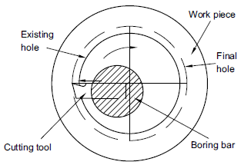
BORING
Boring is an operation of enlarging a hole
Generally the single point tool bit is mounted in the boring bar of suitable diameter commensurate with the diameter to be bored
It is possible to carry out the boring operation in a lathe for limited applications while in drilling and milling machines a large range of holes can be bored using the multiple point cutting tools in addition to the single point tool

Slide 71
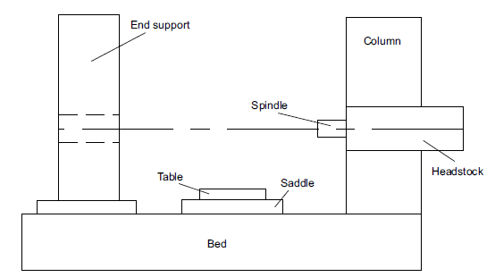
HORIZONTAL BORING MACHINE
Generally heavy work pieces that are difficult to be rotated in the drilling machines, are bored in horizontal boring machines. A drilled hole, which is not properly located, can be made concentric with the axis of rotation of the spindle by the boring operation.
Headstock: It is the heart of the equipment that houses all the spindles with speed and feed arrangement.
Different spindles are available depending upon the power and speed requirements of the different
operations planned. The headstock also provides a station on which other attachments can be mounted.
The spindle feed and hand feed controls are contained in the headstock.
Column: The headstock is supported by the column and guides it up and down accurately by means of guideways. Columns are attached to bases. Some columns are stationary while others move with their bases.
Column base: This base supports and secures the column. It houses the various gear and driving mechanisms.

Slide 72
End-support column: An additional column is sometimes required for operations that involve the use of long boring bars or heavy tools. An outboard bearing in this column is utilized to support the end of bar. This is also called backrest.
Runways: These are used to carry the main column and end-support column in some machines.
Table and saddle: It is provided for locating and clamping work piece. The table has accurate guide ways to move the table in two perpendicular directions (X and Y in horizontal plane).
Bed: Similar to the bed for heavy machine tools to support most of the machine tool parts.
Floor plate: Similar to a stationary bed and is provided with T-slots for mounting work piece.
Cross rail: The cross rail is similar to the cross rail of a planer.

Slide 73
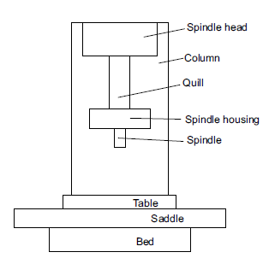
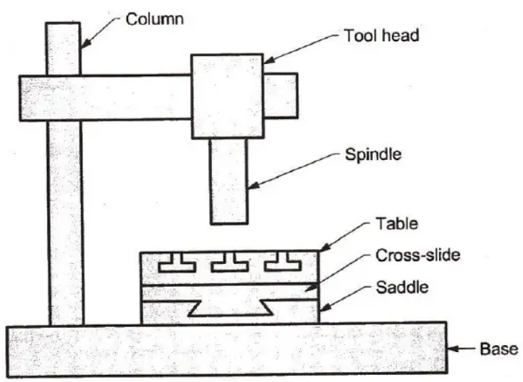
JIG BORING MACHINE
A jig boring machine is similar to a vertical axis milling machine with the table closer to the floor and built with heavy, rigid and accurate construction.
Table and saddle are mounted on the rigid bed that provide the necessary two axes (X and Y) movement for the work piece. A massive column supports all the necessary drives to provide power to the spindle
To provide the Z-axis movement the spindle moves inside a quill which is rigidly supported by the spindle head

Slide 74
All the mechanisms involved in the three axes movement are manufactured under extremely careful and exacting conditions so that there will be no motion lost during tool movement.
The materials for the housing are also carefully chosen so that thermal expansions due to the changes in temperature are minimized.
The jig boring machine must be rugged enough for heavy cuts while remaining sensitive enough for light cuts.

